Slide 1
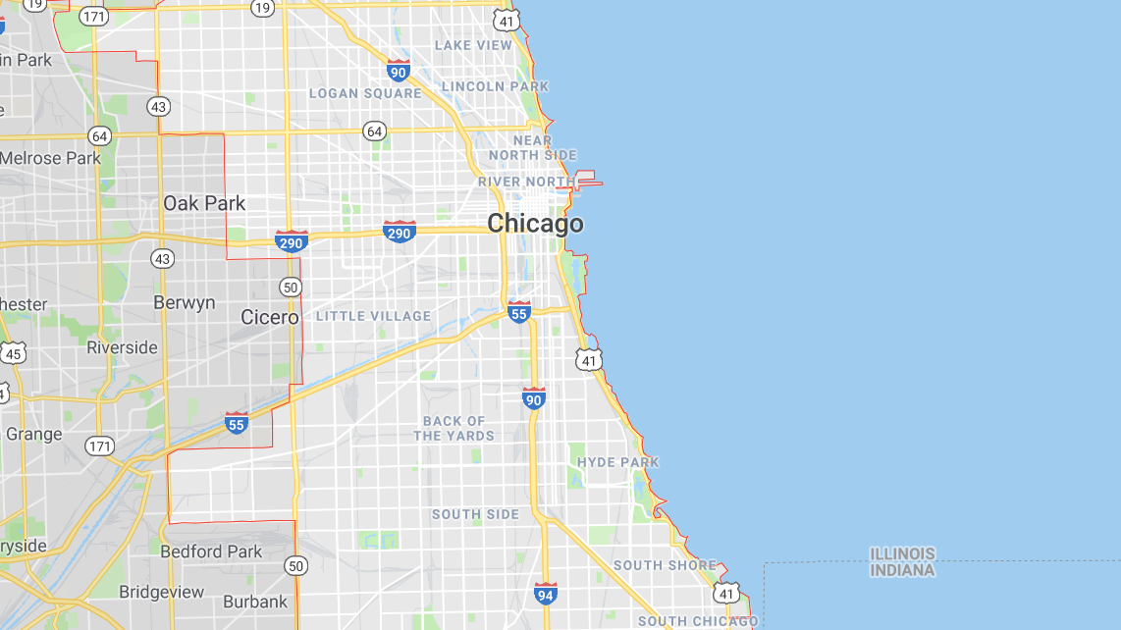
Chicago Traffic Cams & Accidents
Griffin Peifer, Mike Considine, Eddie Licea

Slide 2
Project Motivation & Overview
Why Traffic Cams & Accidents?
We’ve all gotten traffic cam tickets in the past couple years, so we wanted to analyze Chicago city traffic data to identify trends that might help us avoid unfortunate situations like traffic cam violations or accidents in the future
Questions/ Phases of Analysis
What are some observable trends or tendencies we can identify related to car accidents in Chicago
How have the most active traffic cameras and camera violation trends changed over time?
Why have these trends changed the way they have?
(How do they correlate to Chicago’s population or ride share data?)

Slide 3
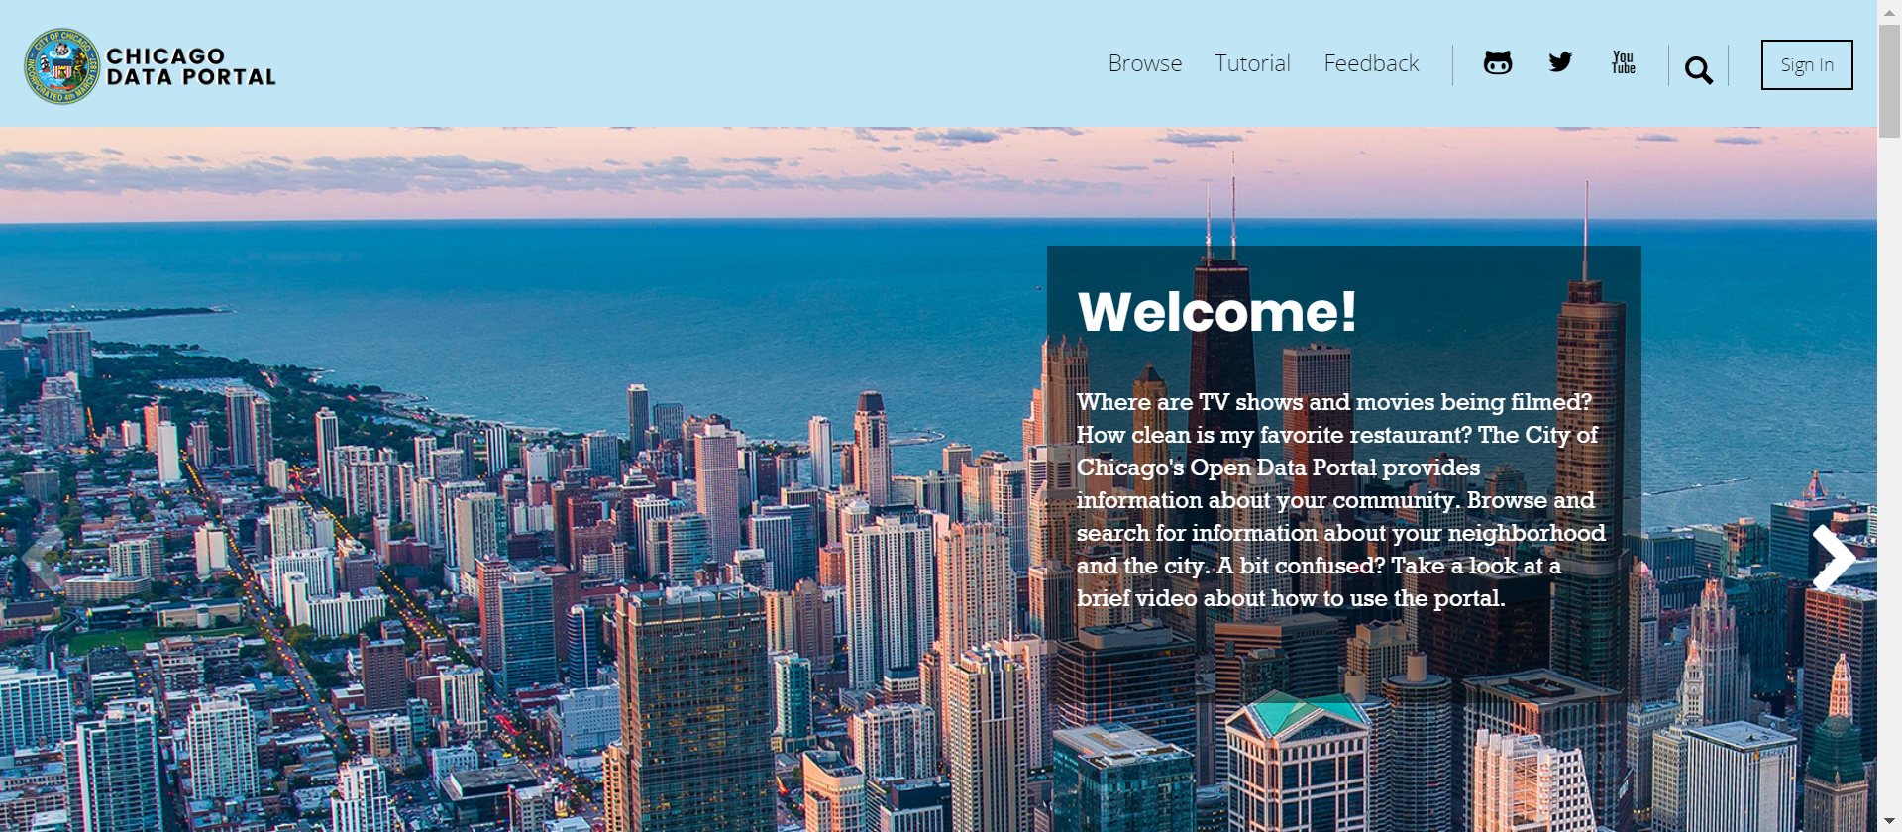
Chicago Traffic Data Source
Data Source – Chicago Data Portal https://data.cityofchicago.org/

Slide 4
Data Cleanup & Exploration
Three Primary Data Sets
Post 2017-2018 Accident Data
Considered the impact of the following on accidents:
Weather conditions
Lighting conditions
Time of year
Part of the city
Red Light Traffic Camera Data
Speed Camera Data

Slide 5
PLOT SHOTS

Slide 6
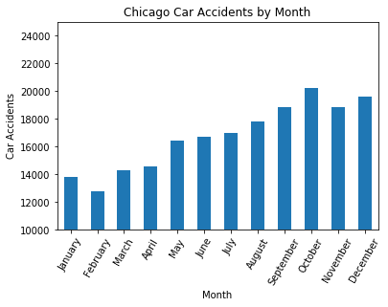
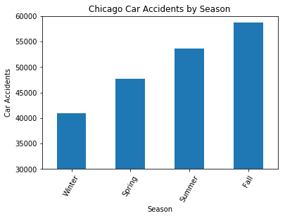
Analysis (1) – Car Accident Observations

Slide 7
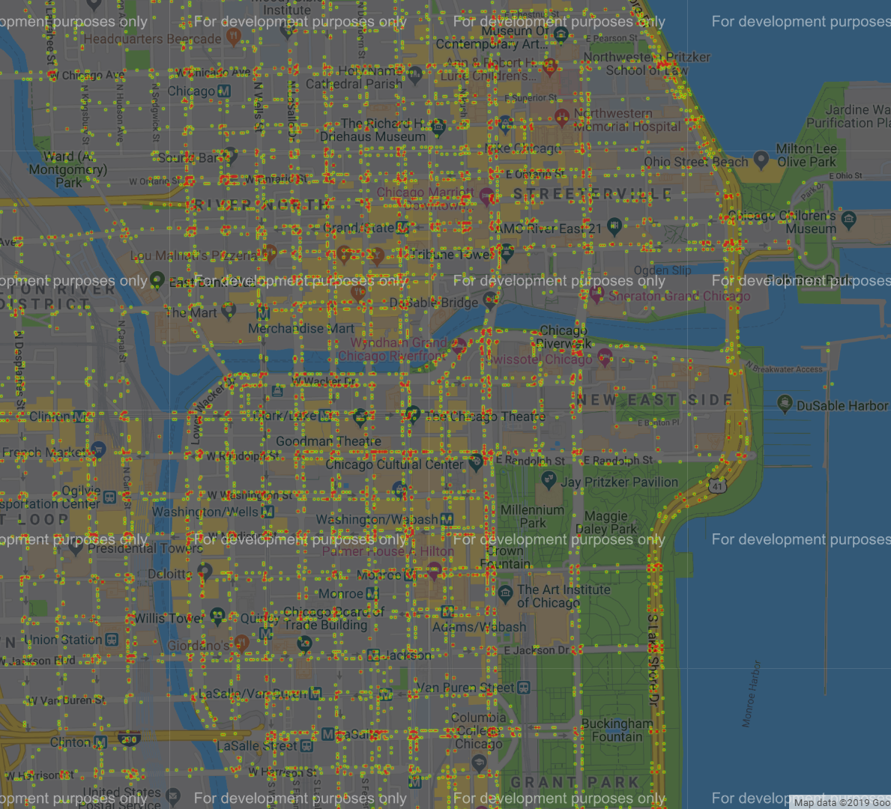
Analysis (1) – Total Car Accidents Heatmap
*Includes car accidents from 2017-2018

Slide 8
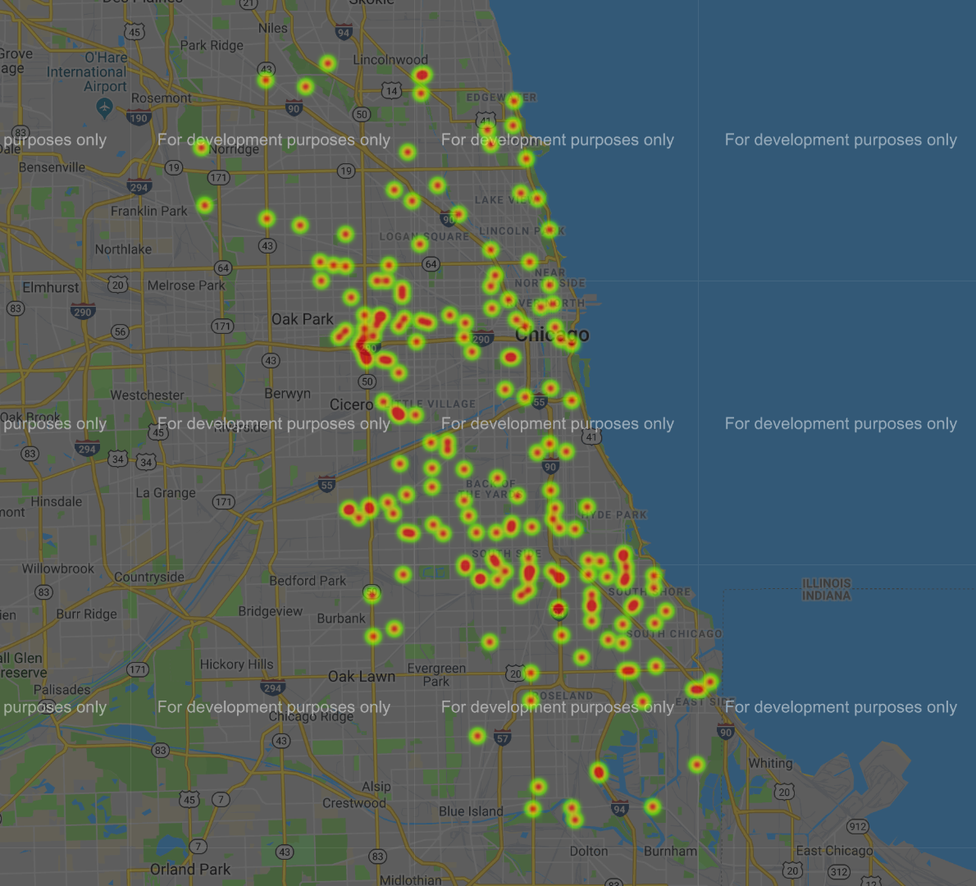
Analysis (1) – Fatal Car Accidents Heatmap
*Includes all car accidents with at least one fatality between 2017-2018
View the fatal car accidents details table in Jupyter Notebook for additional information

Slide 9
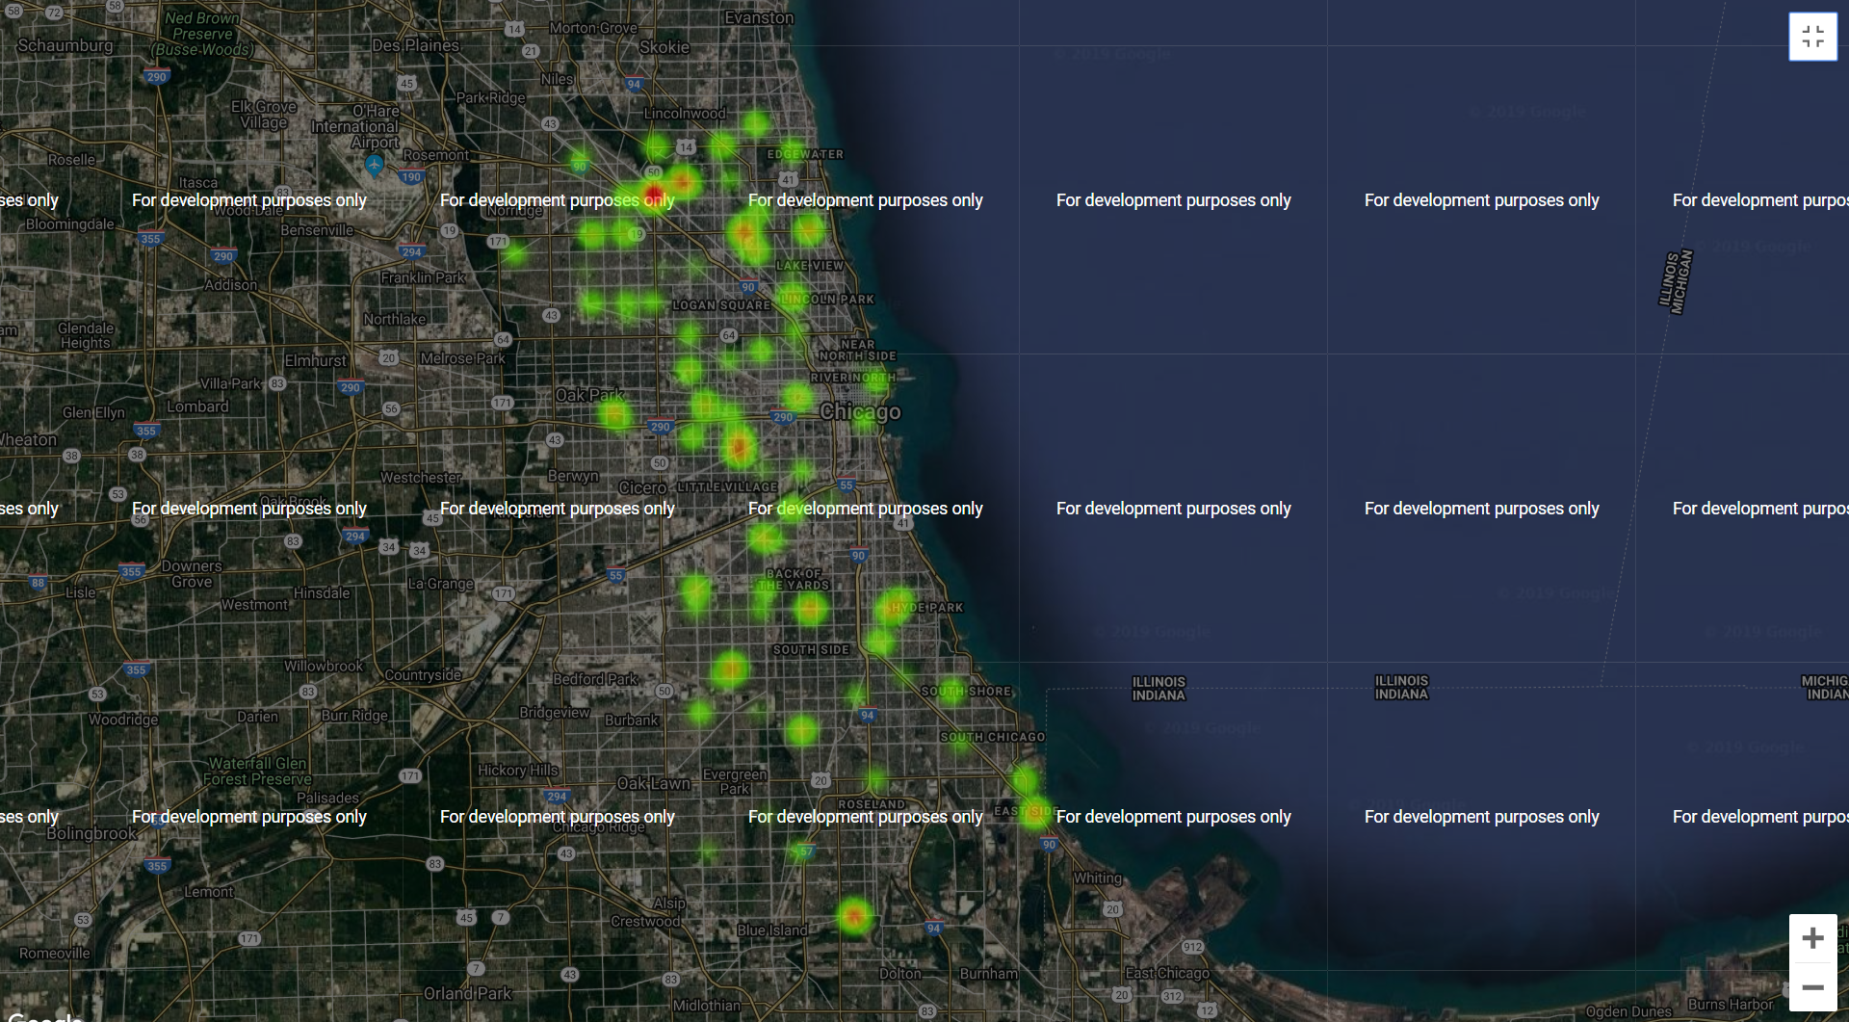
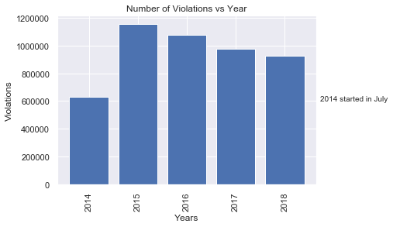
Analysis (1) – Speed Camera Violations

Slide 10
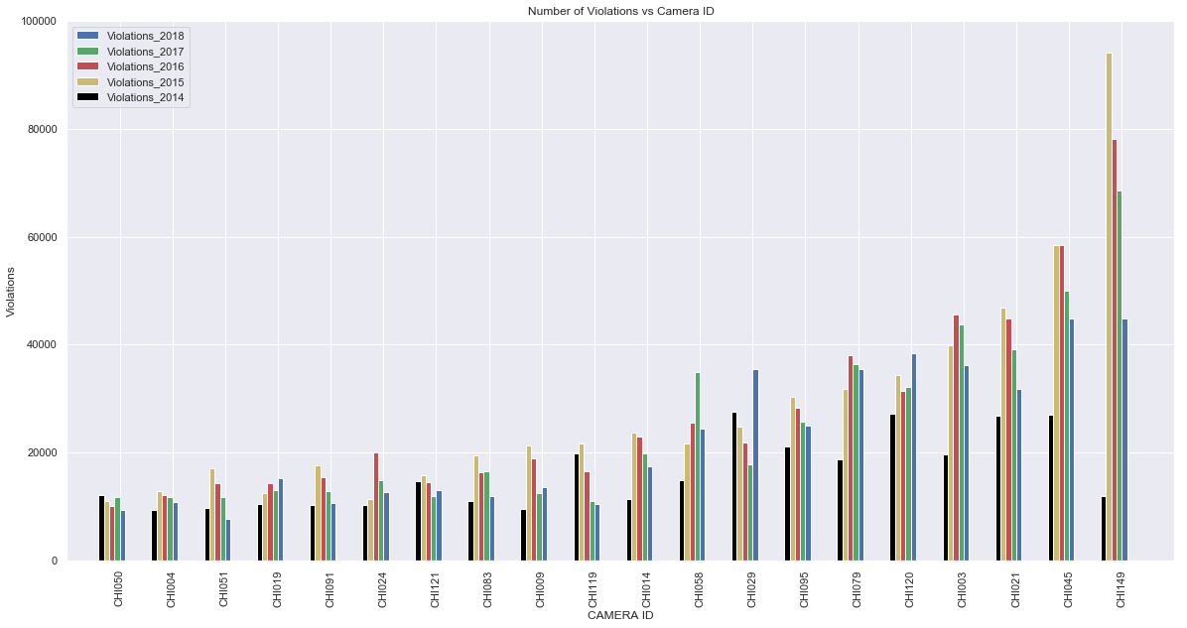
Analysis (2) – Top 20 Most Active Speed Cameras

Slide 11
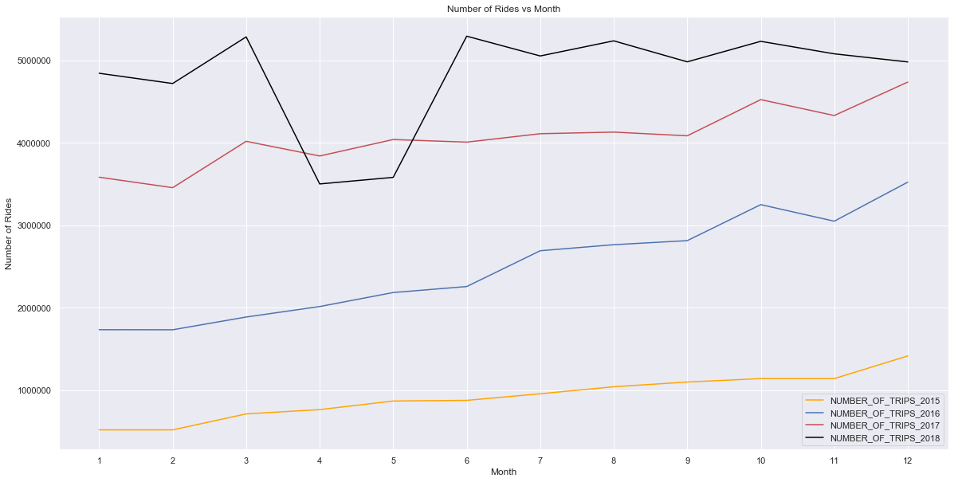
Analysis (3) – Rideshare Rides per Year

Slide 12
Analysis

Slide 13
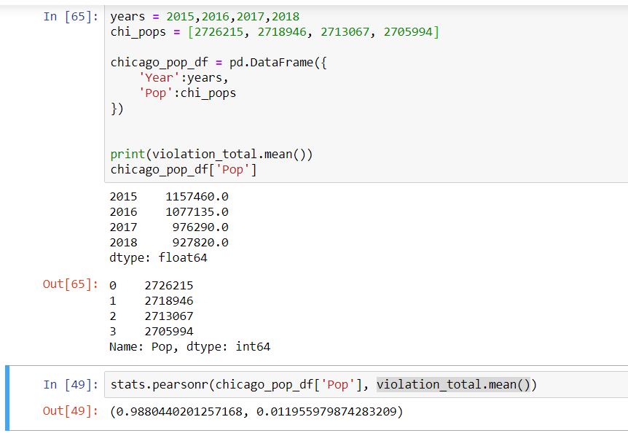
Pearson correlation coefficient measures X and Y. This value has a range between -1, and 1., where 1 is a total positive linear correlation, and -1 is negative linear correlation

Slide 14
Analysis (3) – Pearson Correlation Test
Pearson correlation coefficient measures X and Y. This value has a range between -1, and 1., where 1 is a total positive linear correlation, and -1 is negative linear correlation

Slide 15
Discussion of Findings
Findings
Accidents……

Slide 16
Post Mortem
Additional research options
Incorporating Chicago weather data to compare percentage of days in different conditions to the percentage of accidents in those conditions
Honing the coordinate data of accidents in relation to traffic cameras to get a better idea of how much the camera additions contribute to an accidents
Obtaining more detailed data on ridesharing could help form a better picture of why Chicago traffic behaves the way it does

